Slide 1
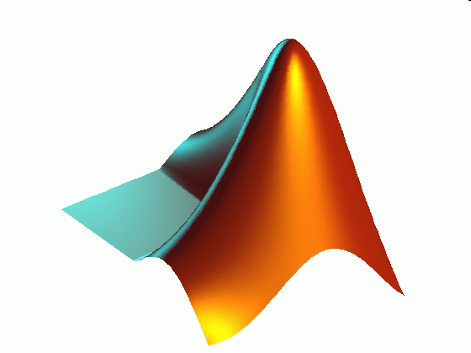
ME 203 Introduction to MATLAB
1

Slide 2
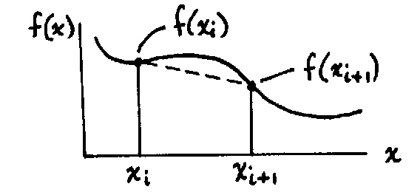
Integration
There are many integration methods in MATLAB. We are only going to look at a few of them. The rest of the functions in Matlab work similarly.
Single Integrals
Trapezoidal Rule – calculates the area under the curve by dividing the range into a series of points and connecting each point using a straight line

Slide 3
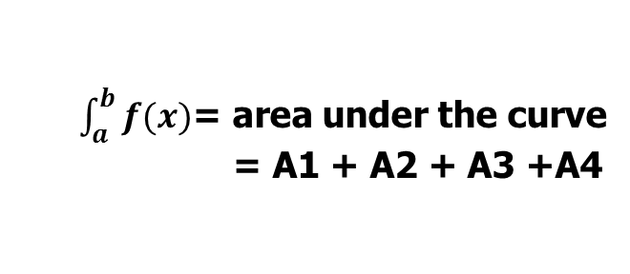
Trapezoidal Rule
f (x)
$\int_{a}^{b}{f(x)}$= area under the curve
= A1 + A2 + A3 +A4
A1
A2
A3
A4
x
a
b

Slide 4
Trapezoidal Numerical Integration
z = trapz(x,y) Integral of y with respect to x by the trapezoidal rule. x and y must be vectors of the same length, or x must be a column vector and y an array whose first non- singleton dimension is length(x). trapz operates along this dimension.
z = cumtrapz(x,y) Computes the cumulative integral of y with respect to x using trapezoidal integration. x and y must be vectors of the same length, or x must be a column vector and y an array whose first non-singleton dimension is length(x). cumtrapz operates across this dimension.

Slide 5
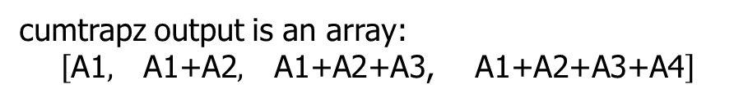
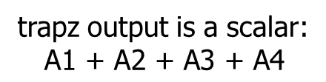
Trapezoidal Rule
trapz output is a scalar:
$$\text{A}\text{1 + }\text{A}\text{2 + }\text{A}\text{3 + }\text{A}\text{4}$$
f (x)
cumtrapz output is an array:
$$\left[\begin{matrix}\text{A}\text{1}, & \begin{matrix}\text{A}\text{1+}\text{A}\text{2}, & \begin{matrix}\text{A}\text{1+}\text{A}\text{2+}\text{A}\text{3, } & \text{A}\text{1+}\text{A}\text{2+}\text{A}\text{3}\text{+}\text{A}\text{4}\end{matrix}\end{matrix}\end{matrix}\right]$$
A1
A2
A3
A4
x
a
b

Slide 6

Example 1
Calculate the integral of sin(x) in the interval [0,$π$] (exact solution is 2)
% Integral example 1
clc; clear all; format compact
%x range
x = linspace(0,pi,100);
%function
y=sin(x);
%calculate integral
z=trapz(x,y)
Result
z =
1.9998

Slide 7

Example 2
Calculate the integral of sin(x) in the interval [0,$π$]. Plot the function and its integral over the range of x.
% Integral example 2
clc; clear all; format compact
%x range
x = linspace(0,pi,100);
%function
y=sin(x);
%calculate integral
z=cumtrapz(x,y);
%plot results
plot(x,y,x,z)
xlabel('x')
legend('sin(x)','\intsin(x)')

Slide 8

Example 3
Calculate the integral of sin(x) in the interval [0,$π$]. Plot the function and its integral over the range of x. You cannot use cumtrapz.
% Integral example 3
clc; clear all; format compact
%x range
x = linspace(0,pi,100);
%function
y=sin(x);

Slide 9
Example 3 (continued)
z=zeros(1,100);
%calculate integral
for i=2:100
z(i) = trapz(x(1:i),y(1:i));
end
%plot results
plot(x,y,x,z)
xlabel('x')
legend('sin(x)','\intsin(x)')

Slide 10
Single Integrals – Alternative method
q = integral (function,xmin,xmax)
Example: Calculate the integral of [sin(x) + cos(x)] in the interval [0,$π$]
(exact solution = 2)
% Integral example 1
clc; clear all; format compact
%given
xmin = 0; xmax = pi;
%function handle
F = @(x) sin(x)+cos(x);
%calculate integral
q = integral (F, xmin, xmax)
Result
q =
2

Slide 11
Multiple Integrals
Matlab Function for Double Integrals
q = integral2 (function, xmin, xmax, ymin, ymax)
Matlab Function for Triple Integrals
q = integral3(function, xmin, xmax, ymin, ymax, zmin, zmax)

Slide 12

Double Integral Example 1
Calculate the following integral: $\int_{2}^{4}{\int_{1}^{2}{6xy^{2} dydx}}$
% Double integral example 1
clc; clear all; format compact
%given
xmin = 2; xmax = 4;
ymin = 1; ymax = 2;
%function handle
F = @(x,y) (6*x.*y.^2);
%compute integral
q = integral2 (F, xmin, xmax, ymin, ymax)
Result
q =
84.0000

Slide 13

Double Integral Example 2
Calculate the following integral: $\int_{0}^{1}{\int_{0}^{1−x}{\frac{1}{\sqrt{x+y}\left(1+x+y\right)} dydx}}$
% Double integral example 2
clc; clear all; format compact
%given
xmin = 0; xmax = 1;
ymin = 0;
%function handles
F = @(x,y) 1./(sqrt(x+y).*(1+x+y));
ymax = @(x) (1-x);
%compute integral
q = integral2 (F, xmin, xmax, ymin, ymax)
Result
q =
0.4292

Slide 14

Triple Integral Example 1
Calculate the following integral: $\int_{0}^{1}{\int_{0}^{π}{\int_{π}^{2π}{\left[z y sin\left(x\right)+x cos\left(y\right)\right] dxdydz}}}$
% Triple integral example 1
clc; clear all; format compact
%given
xmin = pi; xmax = 2*pi;
ymin = 0; ymax = pi;
zmin = 0; zmax = 1;
%function handle
F = @(x,y,z) z.*y.*sin(x)+x.*cos(y);
%compute integral
q = integral3 (F, xmin, xmax, ymin, ymax, zmin, zmax)
Result
q =
-4.9348

Slide 15

Triple Integral Example 1
Calculate the following integral: $\int_{0}^{x+y}{\int_{0}^{π}{\int_{π}^{2π}{\left[z ( sin\left(x\right)+x cos\left(y\right))\right] dxdydz}}}$
% Triple integral example 1
clc; clear all; format compact
%given
xmin = pi; xmax = 2*pi;
ymin = 0; ymax = pi;
zmin = 0;
%function handle
F = @(x,y,z) z.*y.*sin(x)+x.*cos(y);
zmax = @(x,y) x+y;
%compute integral
q = integral3 (F, xmin, xmax, ymin, ymax, zmin, zmax)
Result
q =
-319.2827

